Slide 1
Customer Segmentation of Olist Ecommerce Customers in Sao Paolo using K-Means Method.
By : Nicholas Nehemia
Student of jcdsah-bsd

Slide 2
What is Customer Segmentation?
Market segmentation can be defined as dividing a market into distinct groups of customers, with different needs, characteristics or behavior, who might require separate products or who may respond differently to various combinations of marketing efforts (Kotler & Armstrong, 1999). In segmenting customers, various criteria can also be used depending on the market such as geographic, demographic characteristics or behavior bases. This technique assumes that groups with different features require different approaches to marketing and wants to figure out the groups who can boost their profitability the most.
Notes:
Inti dari dari customer segmentation , adalah membagi customer menjadi beberapa group yang memiliki sifat yang mirip.
Customer segmentation bisa menggunakan beberapa kriteria , diantaranya geografis , Demografis, atau perilaku.
Menurut Teknik customer segmentation , cluster dengan sifat yang mirip akan memiliki respons yang mirip terhadap suatu campaign marketing.

Slide 3
Why is Customer Segmentation Important?
Optimation of Resources
Segmentation is critical because a company has limited resources, and must focus on how to best identify and serve its customers. Individual customer segments are characterized by a certain degree of within-group homogeneity that helps ensure that the members of a segment will respond in similar ways to marketing efforts.
Understanding Customer Positions and Movement:
By using this method, we can see which customers are potential Customers and High Value Customers. Through Customer Relationship Management, we can hopefully convert Potential Customers into High Value Customers, and focus our energy into High Value Customers.
Rerunning the model over periods of time, we can see the growth of each cluster, and evaluate whether the marketing strategies we have employed are effective or not.
Increase Customer Retention and Decrease Customer Churn:
Acquiring a new customer is 5 to 25 times more expensive than retaining an existing one. On the other hand, studies by Bain & Company, along with Earl Sasser of the Harvard Business School, have shown that a 5% increase in customer retention can lead to an increase in profits between 25 and 95%.).
Through this model , we can anticipate and reduce churn.
Notes:
Optimation of Resources :
Penting karena , kita harus bisa mengidentifikasi dimana kita harus membagi sumber daya yang ada, karena targeted marketing memimiliki effisiensi yang lebih tinggi daripada mass marketing.
Hal ini karena menurut teori customer segmention , Segment dengan sifat yang mirip cenderung memberi respons yang sama pada suatu marketing campaign.
Understanding customer position and movement:
-Kita bisa mengengetahui mana customer yang berharga dan bernilai tinggi, dan mana customer yang kurang berharga / sudah churn.
Menurut Growth Share Matrix BCG , kita sebaiknya memberi perhatian paling besar pada segmen yang memiliki growth dan marketshare tertinggi.
Kemudian baru focus pada group yang memiliki kesempatan untuk diconvert menjadi market share tinggi.
Untuk customer yang memiliki value rendah , bisa diberi effort yang kecil juga.
-Kita juga bisa mengerti perpindahan customer dari 1 segment ke segment yang lain dengan running model secara berkala.
Dengan demikian , kita bisa melakukan evaluasi apakah strategi marketing yang kita gunakan sudah efektif atau belum
Increase Customer Retention.
Customer retention itu adalah suatu hal yang penting, dan membutuhkan dana jauh lebih banyak untuk mencari customer baru daripada mempertahankan customer yang ada.
Melalui model ini , diharapkan kita bisa mengurangi churn dengan menjaga hubungan yang baik dengan customer value tinggi.

Slide 4
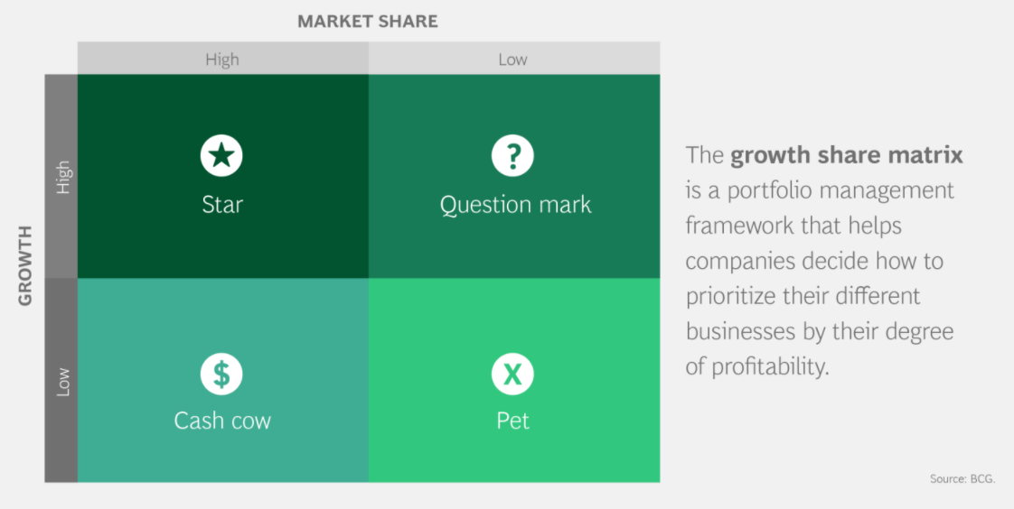
Notes:
Menurut Growth Share Matrix BCG , kita sebaiknya memberi perhatian paling besar pada segmen yang memiliki growth dan marketshare tertinggi.
Kemudian baru focus pada group yang memiliki kesempatan untuk diconvert menjadi market share tinggi.
Untuk customer yang memiliki value rendah , bisa diberi effort yang kecil juga.

Slide 5
RFM Segmentation
RFM segments customers based on their behaviour. The 3 main components are :
Recency: How much time has elapsed since a customer’s last activity or transaction with the brand?
Frequency: How often has a customer transacted or interacted with the brand during a particular period of time?
Monetary: Also referred to as “monetary value,” this factor reflects how much a customer has spent with the brand during a particular period of time.

Slide 6
Why RFM works.
Customers who have purchased from you recently are more likely to respond to your next promotion than those whose last purchase was further in the past. This is a universal principle which has been found to be true in almost all industries: insurance, banks, cataloging, retail, travel, etc. It is also true that frequent buyers are more likely to respond than less frequent buyers. Big spenders often respond better than low spenders. (Arthur Hughes)
The top 20 % of people are the most Valuable customers, and the people who are most likely to respond.
Notes:
Customer yang membeli produk dari kita baru-baru ini cenderung lebih menanggapi promosi daripada yang sudah lama.
Begitu juga customer yang lebih sering membeli juga cenderung lebih menanggapi promosi daripada yang jarang membeli.
Begitu juga dengan orang yang memiliki nilai monetary lebih tinggi.

Slide 7
Problem Statement
We would like do drive down marketing cost through Targeted Marketing based on Customer Segmentation based on RFM Matrix.

Slide 8
Data Used
For this Customer Segmentation Case, we use Brazzilian E-Commerce Public Dataset by Olist from Kaggle.
Data yang ada pada Customer Segmentation dari tahun 2016 – 2018.
Notes:
Background

Slide 9

What Is Olist?
Olist operates an online e-commerce site for sellers, that connects merchants and their products to the main marketplaces of Brazil. It has developed a platform for shopkeepers of all sizes and segments to register their products to be sold at the Olist store within Brazil's top retailers.

Slide 10
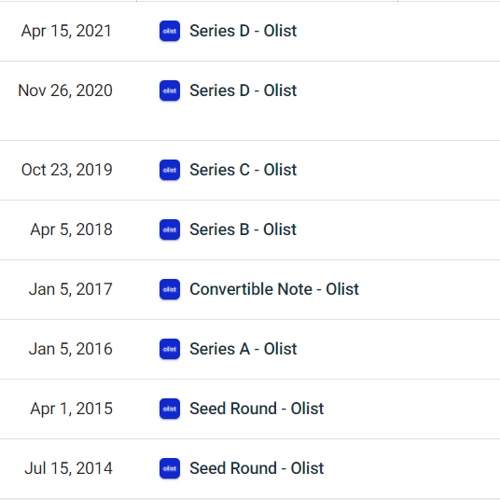
At the date of the last data within the data set , Olist has just Received it’s series B Funding. At this point ,growth is what is important, and through customer segmentation we can keep customer churn low , and also know who are our potential customers.
Funding
Notes:
Olist baru saja menerima Investasi Series B , dan biasanya pada series B , start-up akan focus pada perluasan pasar. (Growth) Jadi dengan customer segmentation ini , bisa mengetahui Customer Potensial , dan mengconvert mereka menjadi customer high value.

Slide 11
Workflow
Import Data from CSV
Merge Dataframes from each CSV using Relevant Column
Create RFM Matrix
Check Missing Values
Clustering
Cluster EDA

Slide 12

Notes:
Yang dipakai untuk Analisa RFM :
Orders
Order_items
Order_payments
Untuk Analisa preferensi :
Order
Order_items
Product_id
translate

Slide 13
RFM Metrics Used
Arthur Hughes uses Equal Binning Frequency in his RFM Matrix, but in this case this method is inappropriate , as most of the data in Frequency (Over 14000 data /16000 of total data) has a value of 1. This will create multiple bins with the same value. So for this dataset , we used Quartiles of category, and for the Frequency category we use a special method.
def rfm_price(x):
lower_quartil=42.90
median=79.99
upper_quartil=149.81
if x<=lower_quartil:
val=1
elif lower_quartil<x<=median:
val=2
elif median<x<=upper_quartil:
val=3
else:
val=4
return val
def rfm_freq(x):
lower_quartil=2
median=3
upper_quartil=4
if x<=lower_quartil:
val=1
elif lower_quartil<x<=median:
val=2
elif median<x<=upper_quartil:
val=3
else:
val=4
return val
def rfm_recency(x):
lower_quartil=-336.0
median=-209.0
upper_quartil=-112.0
if x<=lower_quartil:
val=1
elif lower_quartil<x<=median:
val=2
elif median<x<=upper_quartil:
val=3
else:
val=4
return val

Slide 14
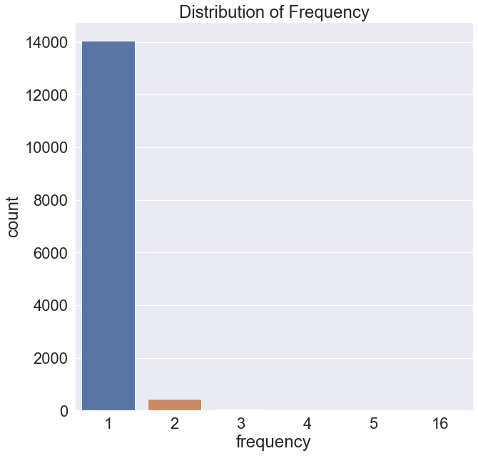
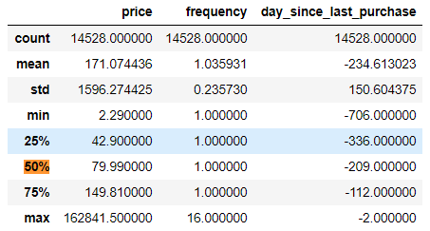
Frequency Metric
From the Frequency metric, we can see that the 1 and 2 far outshine the other value, causing both the mean , and median , and quartiles to have a value of one. That is why we use the RFM as before.

Slide 15
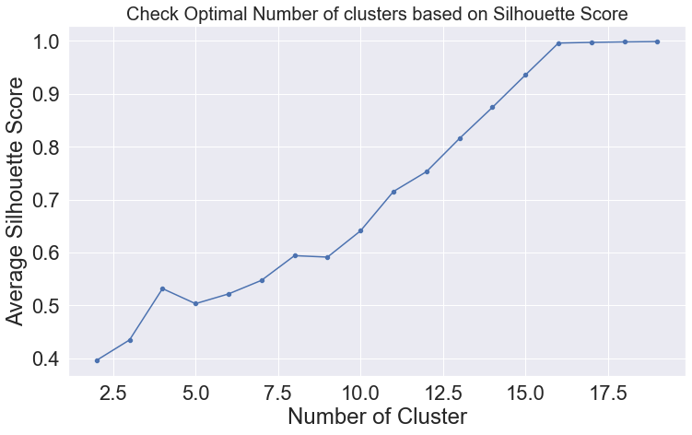
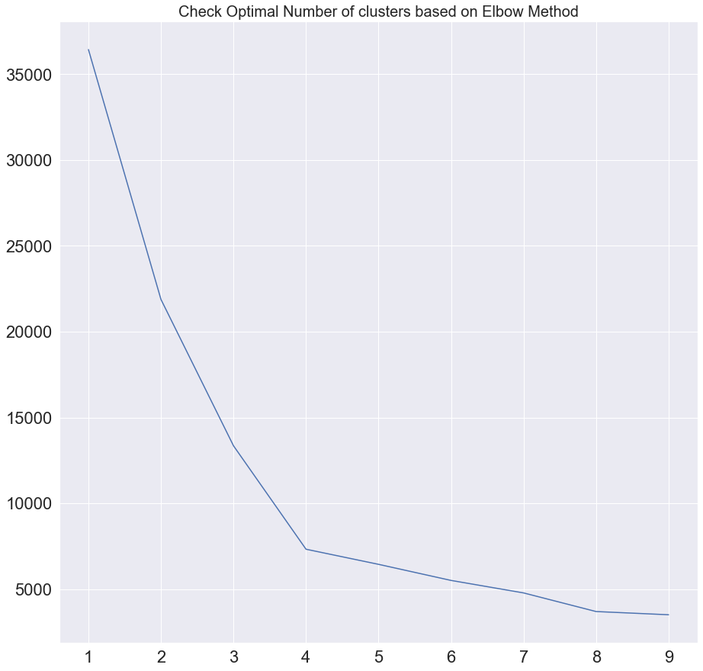
Validation Metrics Used

Slide 16
Validation Metrics Used
Both the Silhouette score and Elbow method points to the K-value of 4.
We can also refer to the Boston Consulting Group’s growth share matrix to help us define the number of clusters.

Slide 17
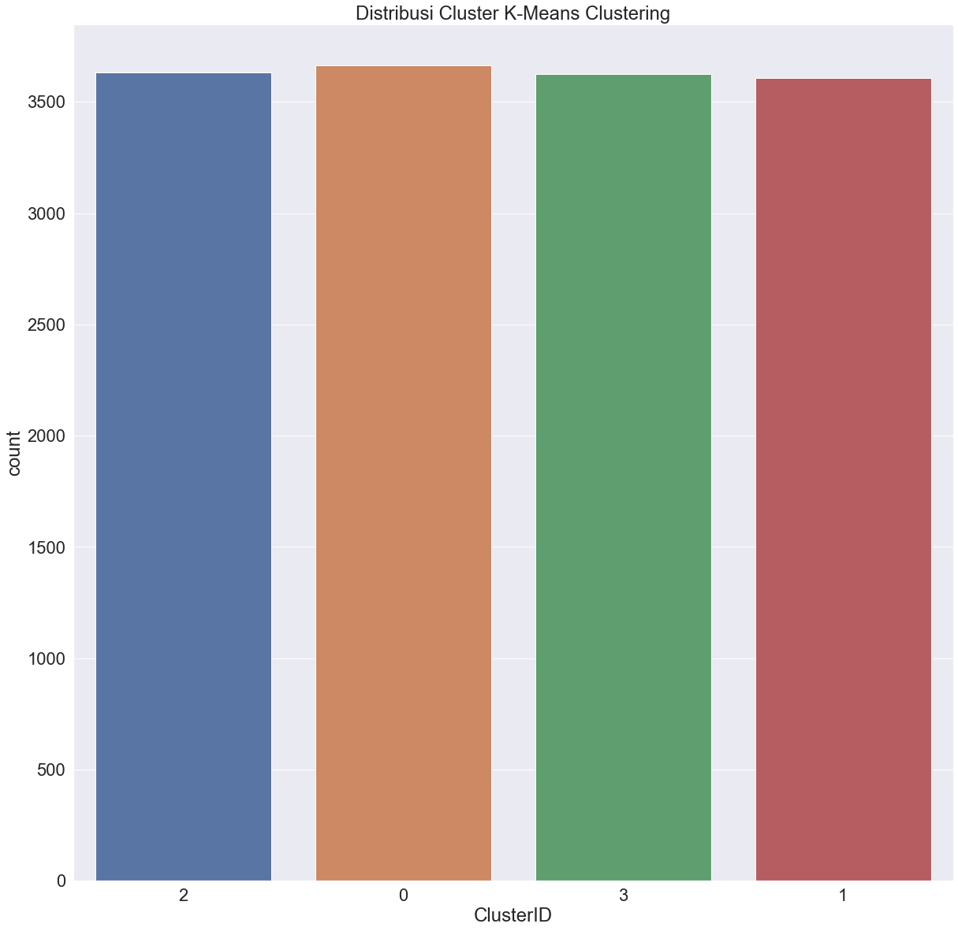
Cluster Distribution

Slide 18
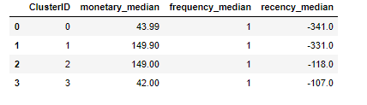
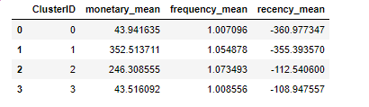
Cluster Statistics
Cluster Median
Cluster Mean
Rank | Recency | Frequency | Monetary
1 | Class 3 | Class 2 | Class 1
2 | Class 2 | Class 1 | Class 2
3 | Class 1 | Class 3 | Class 0
4 | Class 0 | Class 0 | Class 3
Cluster | Definition
Class 0 | Low Value , Churned
Class 1 | High Value , Churned
Class 2 | High Value, Active
Class 3 | Potential Customer
Notes:
Berdasarkan data yang ada ,
Sebenarnya data distribusinya tidak normal , seharusnya menggunakan median. Tetapi, perbedaan frequensi menjadi tidak terlihat saat menggunakan median, oleh karena itu saya menggunakan mean.
Class 0 Memiliki recency dan frequency paling rendah , dan monetary relative rendah
Class 1 Memiliki Recency rendah , frequency agak tinggi, dan monetary relative tinggi
Class 2 Memiliki recency yang relative tinggi, frequency yang tinggi , dan monetary yang relative tinggi juga
Class 3 Memiliki recency yang paling tinggi tinggi , Frequency yang relative tinggi , dan Monetary yang paling rendah.

Slide 19
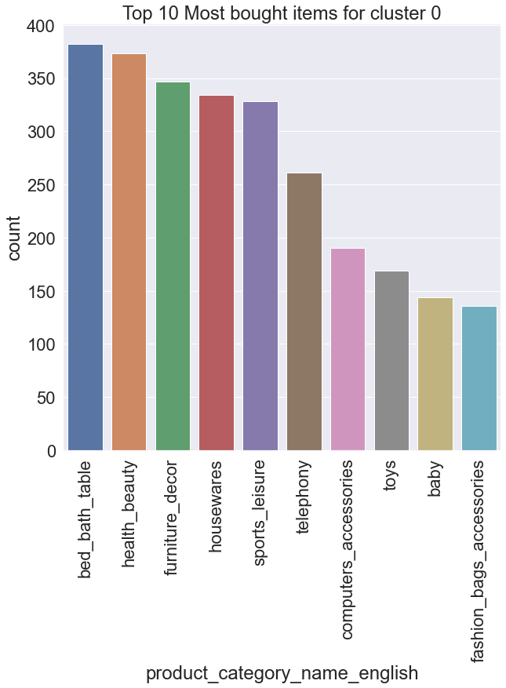
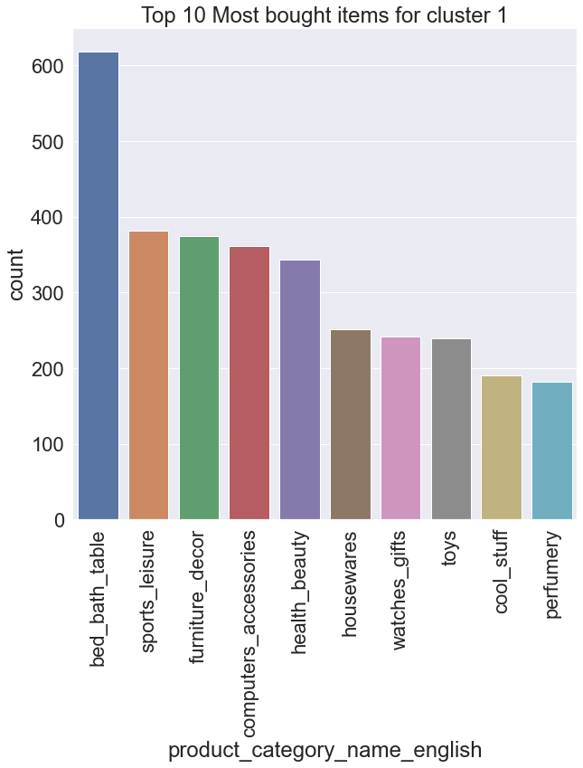
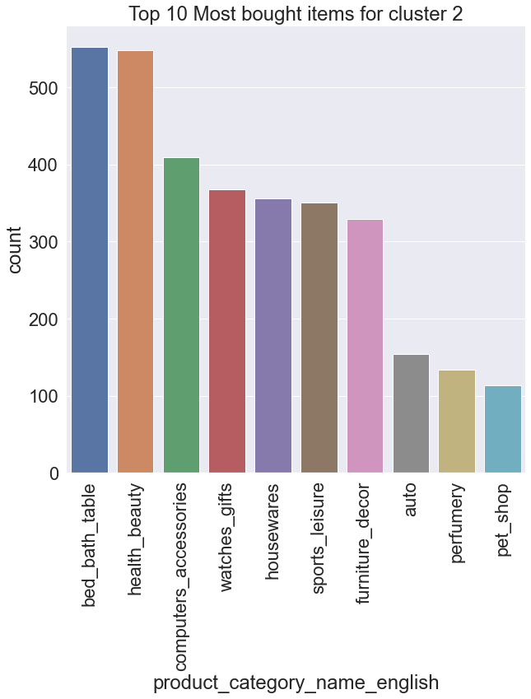
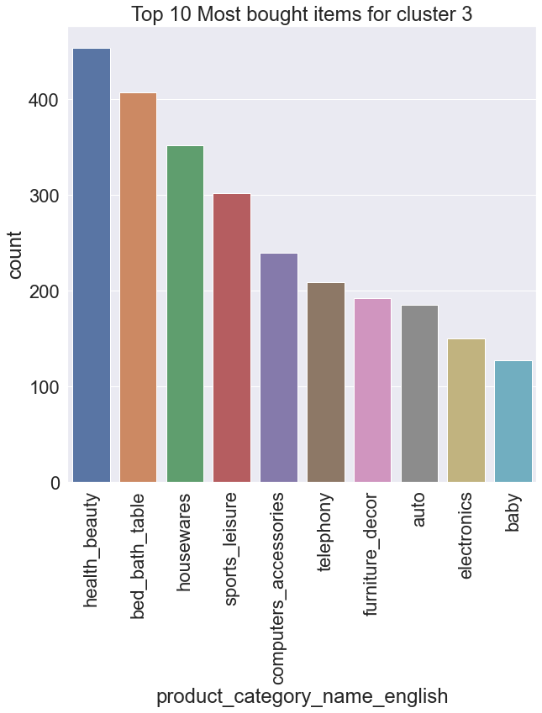
Popular Categories for Each Cluster
Notes:
Personalize Offers
Salah satu cara meningkatkan penjualan bisa dengan melakukan personalized offers. Bisa dilakukan promosi dengan penekanan pada barang tertentu untuk menstimulasi pembelian oleh segmen yang ingin kita target.
Personalised offers can boost conversion rates by up to 10%. RFM analysis allow brands to better customers and offer them personalised offers at the right time to incentivize a desired action.

Slide 20
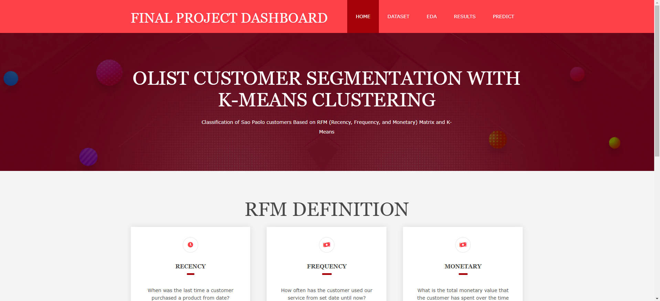
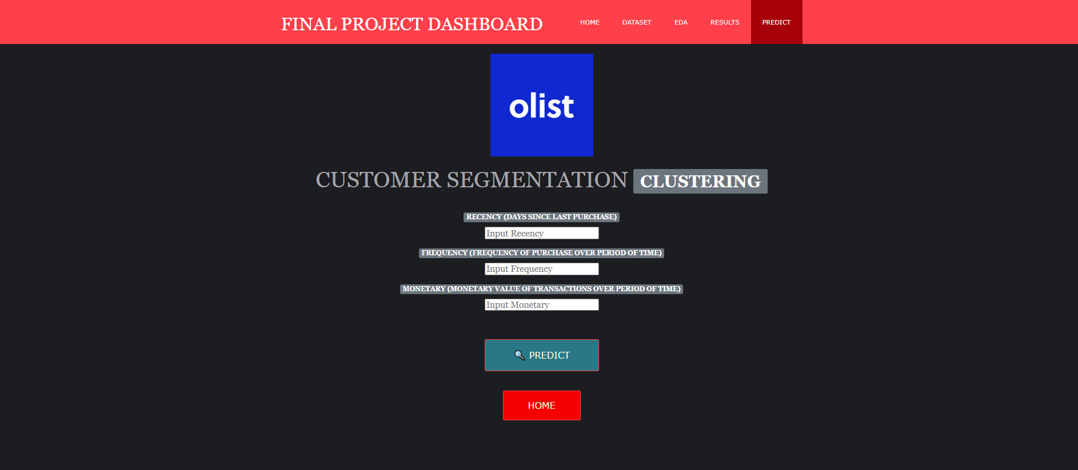
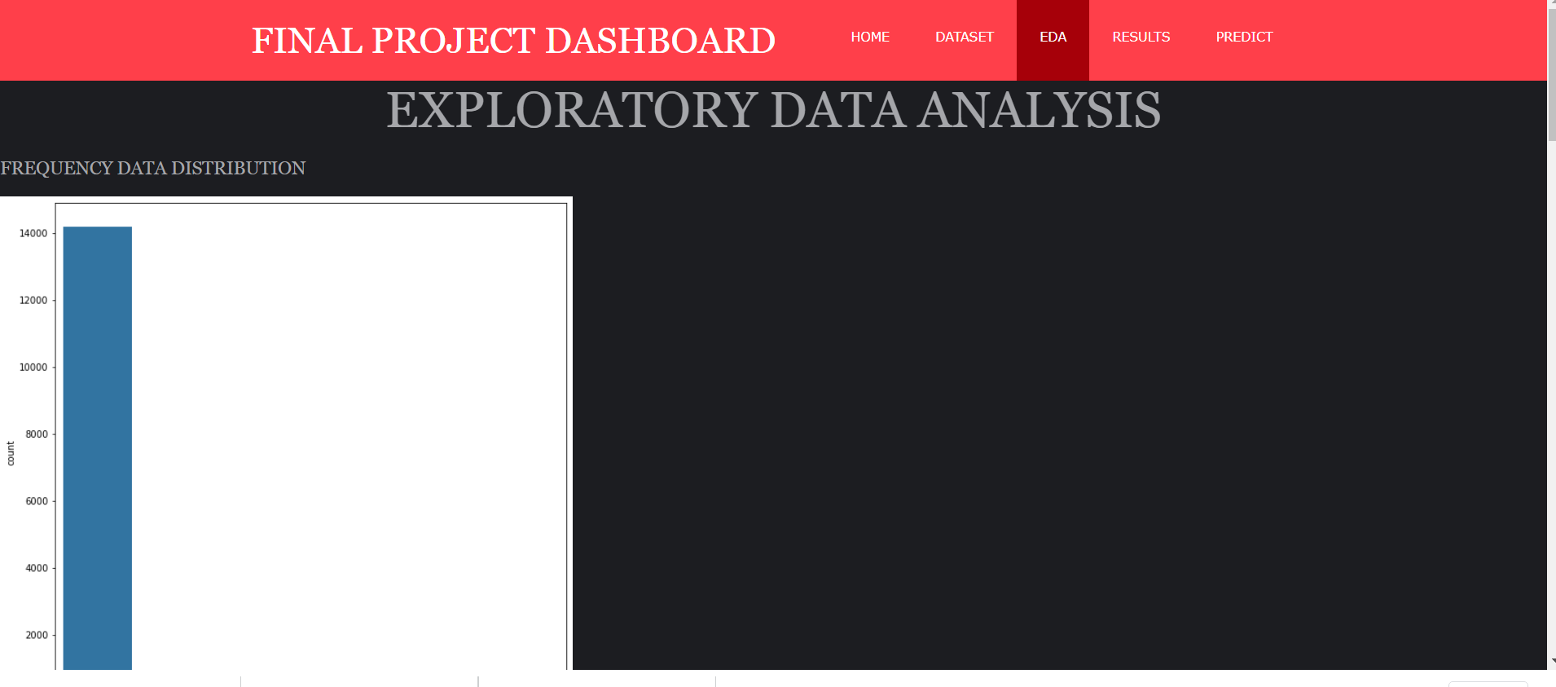
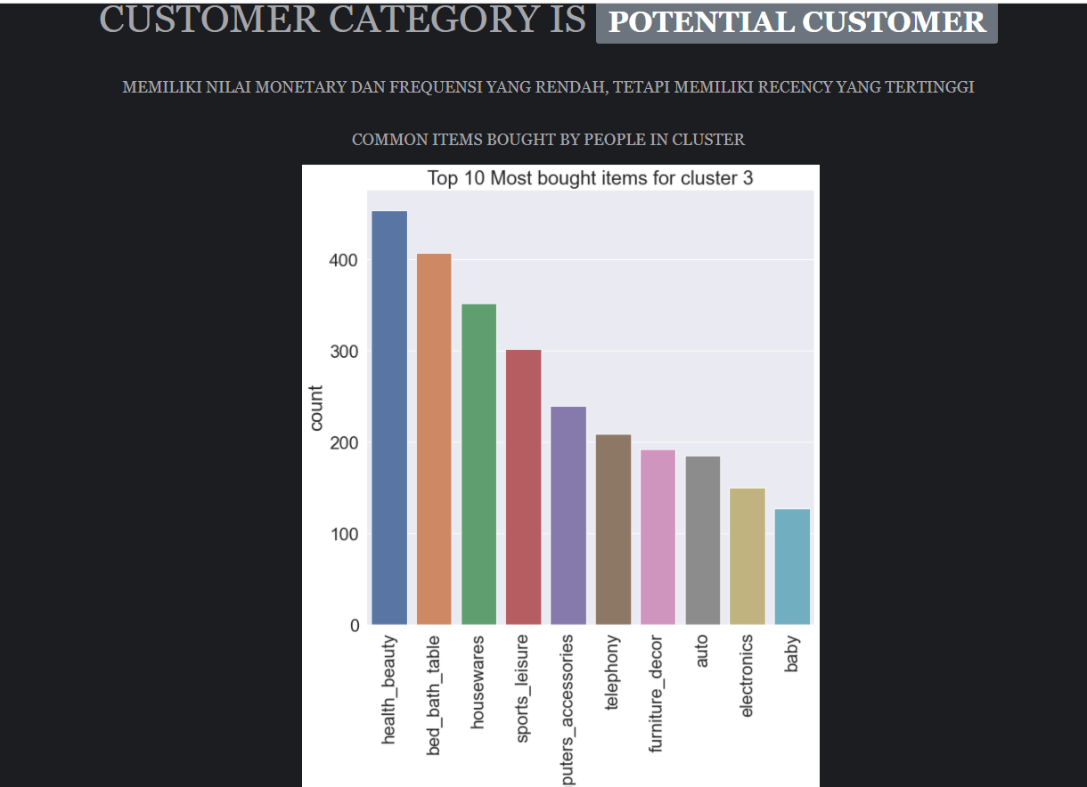
Flask Deployment

Slide 21
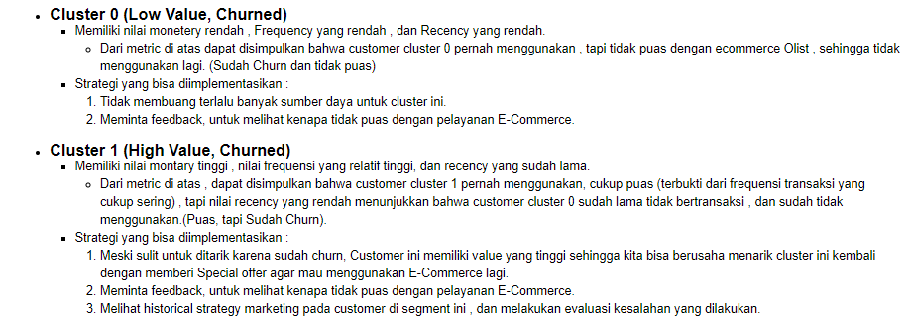
Kesimpulan

Slide 22
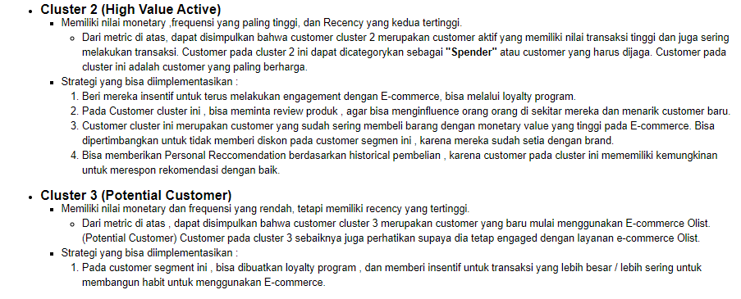
Kesimpulan

Slide 23
Terima Kasih

